Slide 1
Downtown Greenfield DORA
What is DORA?
A Designated Outdoor Refreshment Area (DORA) allows patrons 21-years and older to purchase alcoholic beverages from approved businesses within the DORA and carry them outside to be consumed within the DORA’s boundaries. Beverages may be taken around the designated DORA, either while relaxing outdoors, enjoying one of the many downtown events or while shopping at retailers permitting DORA beverages in their businesses.

Slide 2
Why a DORA?
33 cities in Indiana, including our neighbors in Shelbyville, Fortville and Noblesville have already taken advantage of the Indiana legislation allowing them to establish a DORA. The city’s goal is to facilitate a vibrant setting that promotes economic development and enhances the overall downtown experience.

Slide 3
Benefits of a DORA?
Boost Tourism in the Downtown
New Revenue Source for Restaurants and Bars
Increased Revenue and Spending in Retailers within the DORA Boundaries
Boost to Local Economy via Increase in Food & Beverage Tax Revenue
Easier Process for Organizations Hosting Downtown Events in the DORA

Slide 4
Frequently Asked Questions
Do I need to post a sign?
We will require posting of signs by designated permittees, vendors and retailer permittees that are participating in the DORA district so that a person will know whether they can purchase beverages or enter the business with an open container of alcohol. Non-participating business owners will have the option to place a sign indicating they DO NOT participate in the DORA district.

Slide 5

Examples of Signage in other communities

Slide 6

Examples of Signage in other communities

Slide 7

Examples of Signage in other communities

Slide 8
Who is responsible for purchasing signage?
Examples from Greensburg
65 non reflective street signs $1500 – City of Greenfield
10,000 stickers for cups $78 – Greenfield Main Street
Window Clings for participating businesses $80 – Greenfield Main Street

Slide 9
What cups will we use?
Designated Permittees and Vendors shall only use a clear designated cup with a printed DORA sticker on it. The stickers will be printed by Greenfield Main Street staff. The designated cup style and logo will be made available to all Designated Permittees and Vendors upon finalization to ensure uniformity.

Slide 10
Can people enter and leave my business with alcoholic beverages?
A Designated Permittee or a Vendor may allow a person to exit their premises into the DORA with not more than two (2) open alcoholic beverages.

Slide 11
What are the fill limits of the beverages?
Beer or flavored malt beverages: up to sixteen (16) ounces.
Wine, cider, or a premixed cocktail up to twelve (12) ounces.
Liquor or a liquor-based cocktail: up to ten (10) ounces, including up to two (2) ounces of liquor.
A person may not consume an alcoholic beverage in public areas of the DORA that was purchased outside of the DORA.

Slide 12
Can outside drinks be brought into a DORA?
A person may not consume an alcoholic beverage in public areas of the DORA that was purchased outside of the DORA. This will help safeguard against people sitting outside the barricades at any Depot Street concert and drinking from their coolers.

Slide 13
Can a business inside the DORA refuse to allow alcoholic beverages onto their property?
A business located in the DORA district may, on a nondiscriminatory basis, refuse to allow persons to enter their business with an alcoholic beverage.

Slide 14
Are there any timing requirements to the DORA, or is it 24/7?
The hours for Greenfield’s DORA have not been set but will be written into the City Ordinance once it is adopted. The proposal will be that DORA will be operational all year, from 12:00p.m. to 10p.m. Monday through Thursday and 10:00a.m. to 11:00p.m. Friday through Sunday.

Slide 15
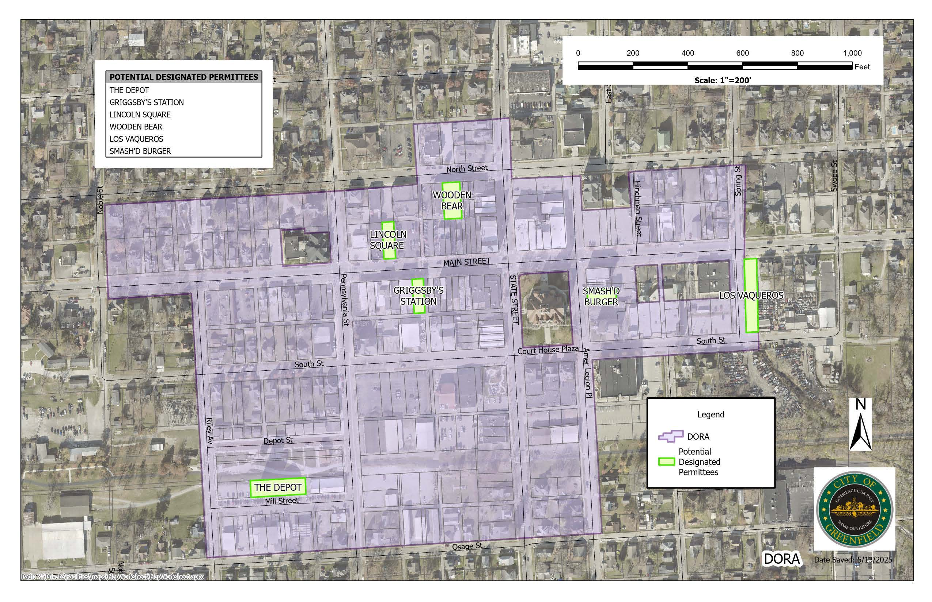
Map of proposed DORA district

Slide 16
Areas restricted on the map
Greenfield Central Community School Corporation and their parking lot
Greenfield Christian Church and their parking lot on Main Street and East Street
Bradley United Methodist Church and their parking lot to the west of the church as well as the lot on the SW corner of Main Street and Pennsylvania Street

Slide 17
Is there any cost or fee to be a Designated Permittee in the DORA?
There is no cost at this time, provided however that each Designated Permittee will be required to purchase their own DORA Cups. We may reassess depending on the cost of operating the DORA (i.e. public safety, sanitation, permit administration, etc.).

Slide 18
Will there be signage to mark the boundaries of the DORA district?
Yes, we will have signs designed and placed around the DORA district indicating that you are entering or leaving the approved area. The signs will have QR codes that will provide detailed information of the ordinance guidelines pertaining to the DORA district.

Slide 19
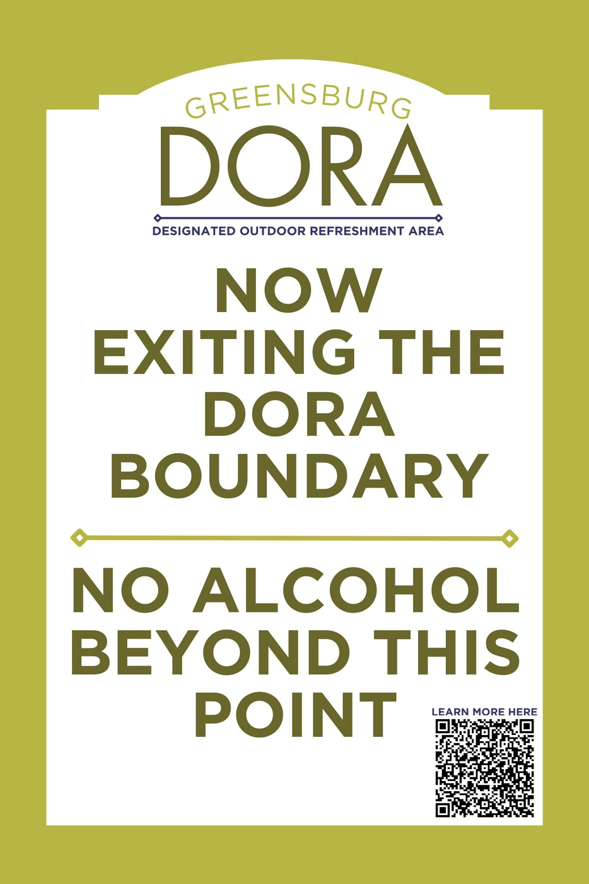
Example of Boundary Signage

Slide 20
Will there be vendor areas within the DORA?
Yes, the proposed areas are Depot Street Park, Courthouse Plaza & the Living Alley.

Slide 21
Are businesses located outside of the DORA allowed to cater inside the DORA and provide alcohol as a regular Designated Permittee? Is that based on an event, or open-ended?
Yes. A business outside of the DORA may apply to be a vendor and be located within a “vendor location” area during a scheduled event.

Slide 22
Letters of support from other communities and local businesses

Slide 23
Who is the main POC for DORA processes, questions, etc.?
Please contact Greenfield Main Street, Inc
Heather Condra Executive Director with any questions, etc. director@greenfieldmainstreet.org 317-649-0890 https://www.in.gov/atc/alcohol-permit-resources/designated-outdoor-refreshment-areas/

